Slide 1
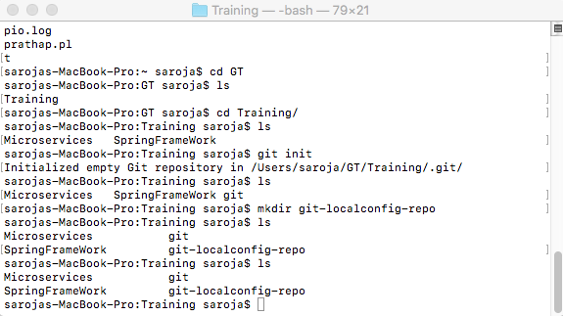

Slide 2
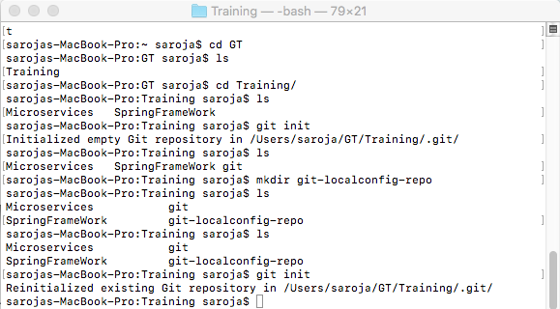

Slide 3
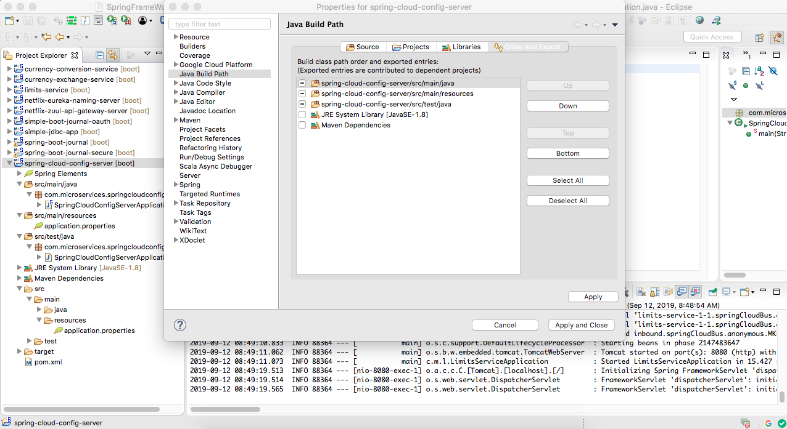

Slide 4
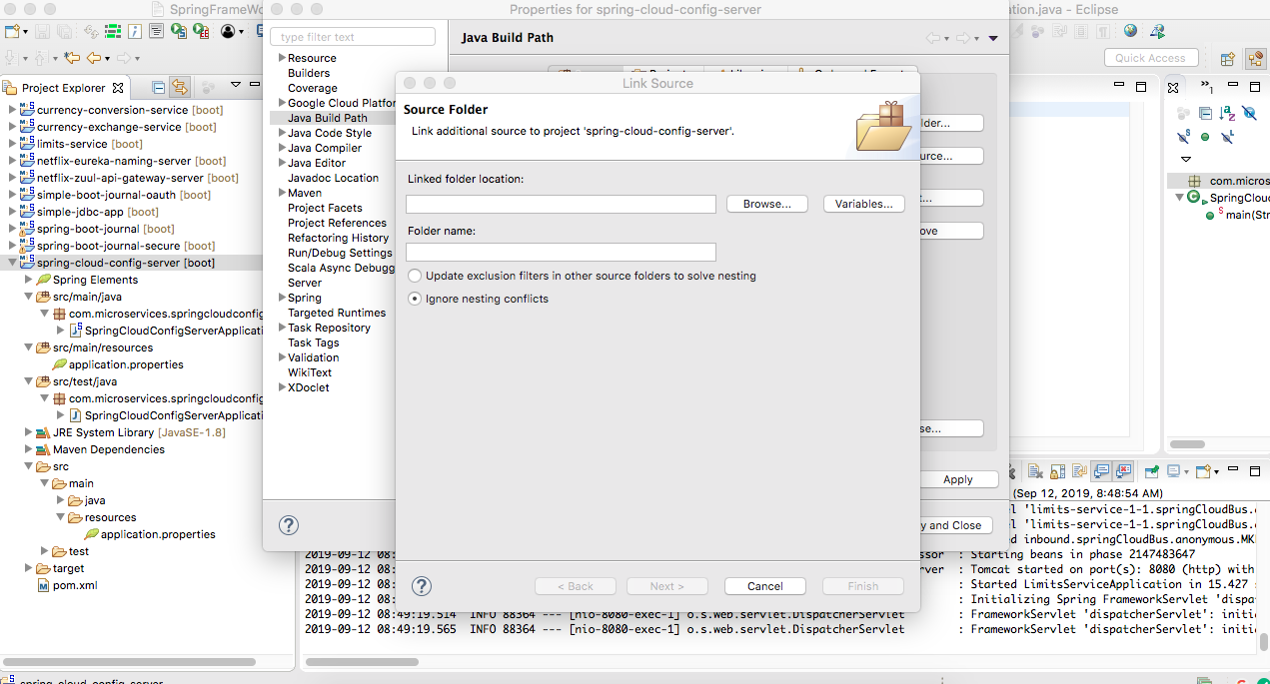

Slide 5
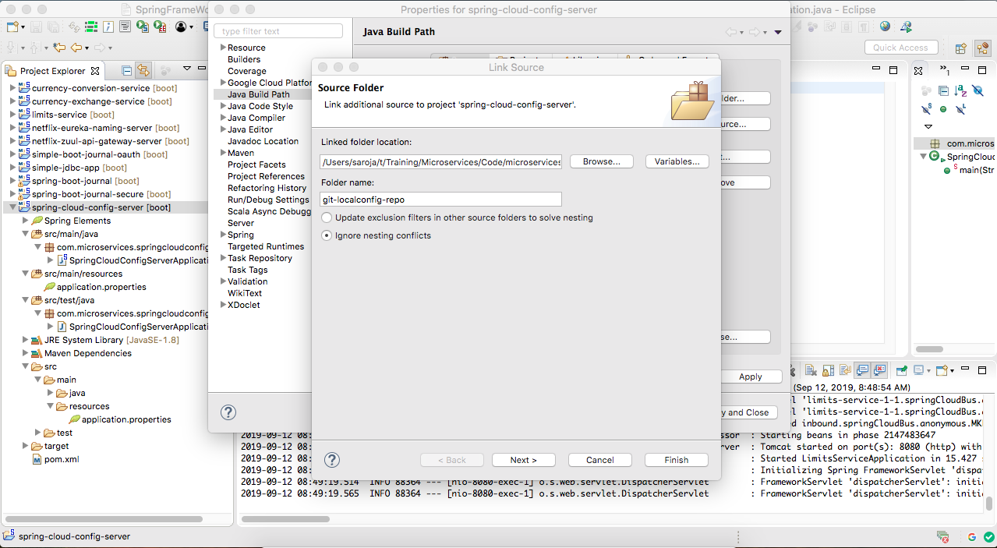

Slide 6
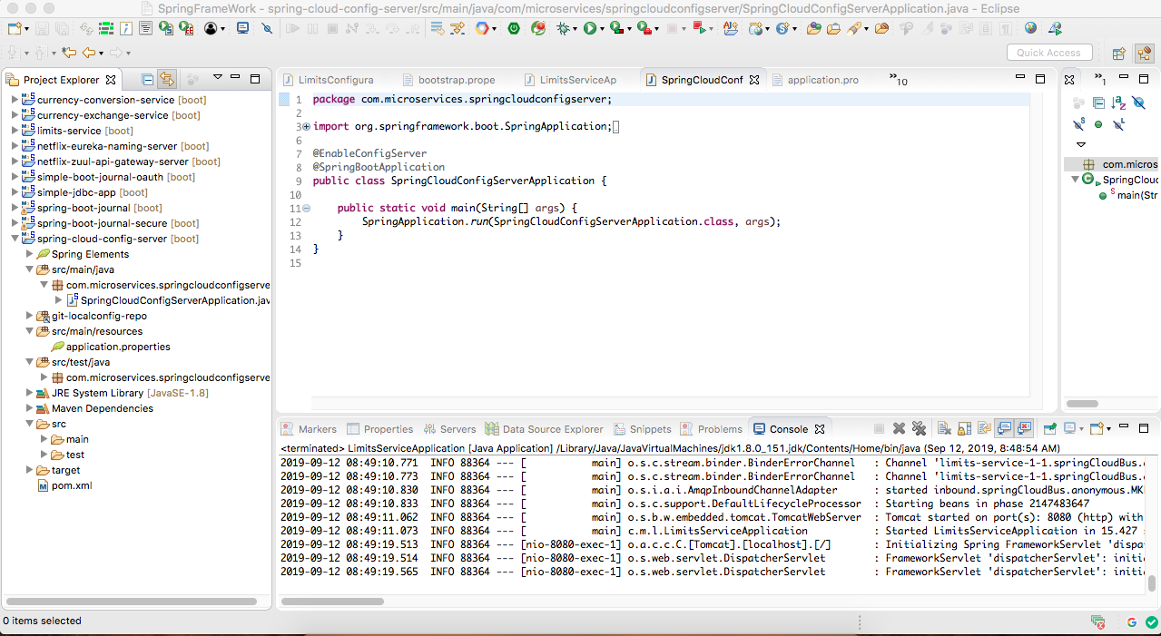

Slide 7
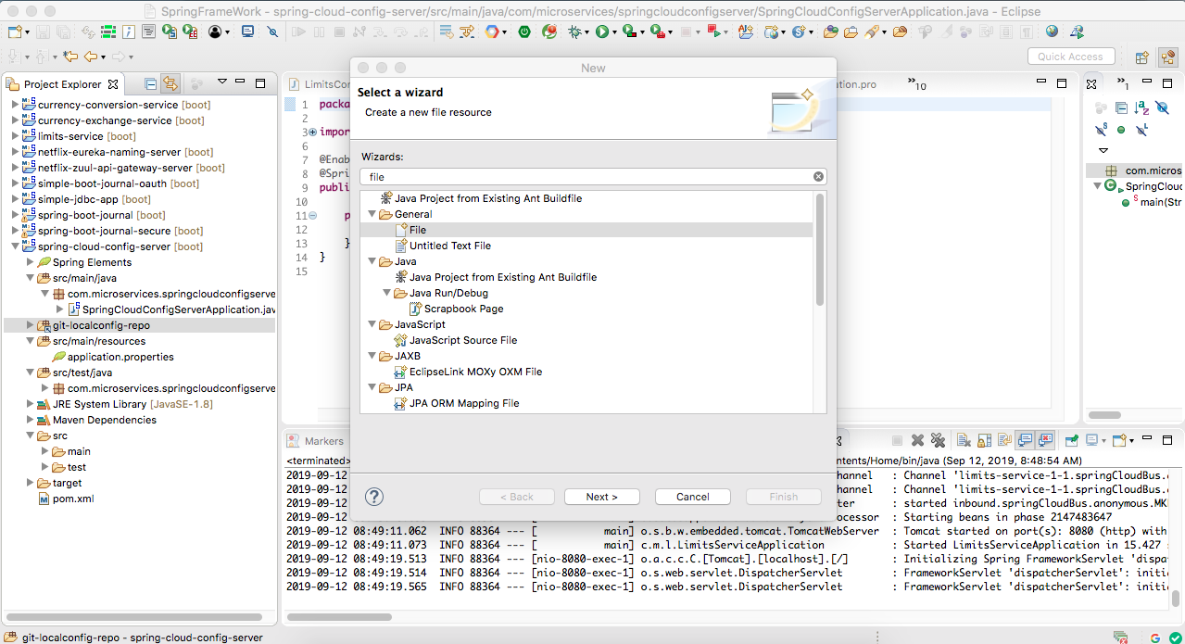

Slide 8
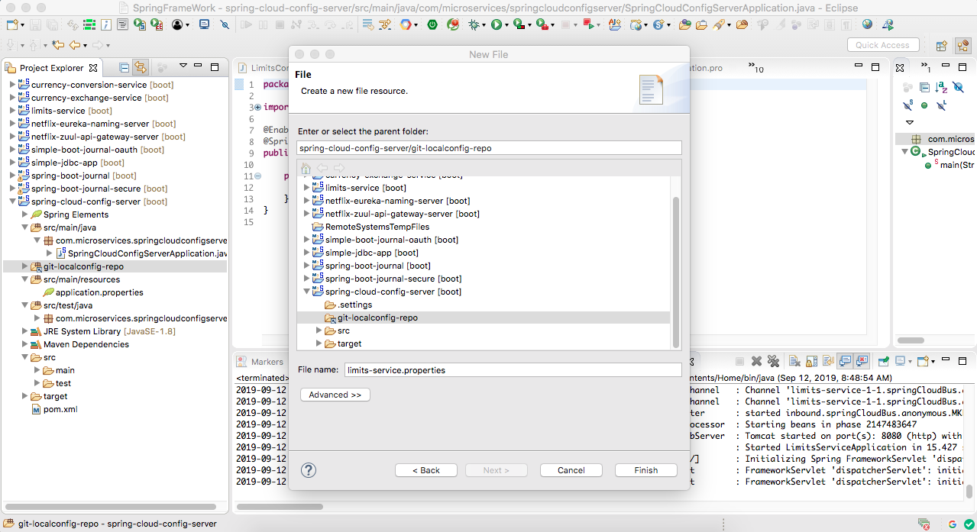

Slide 9
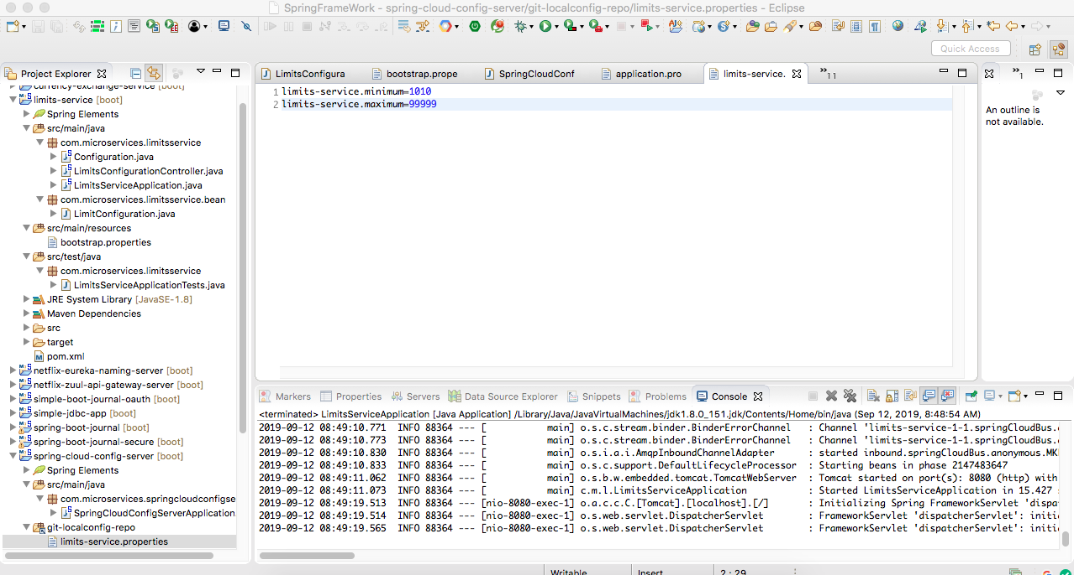

Slide 10
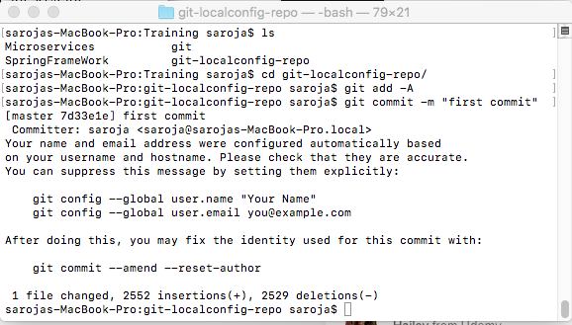

Slide 11
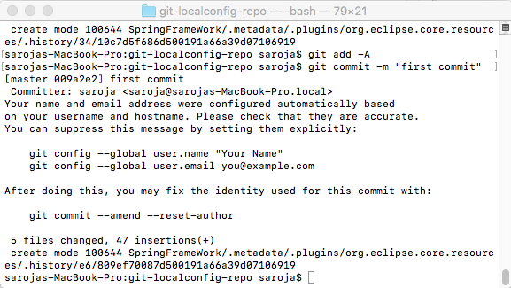

Slide 12
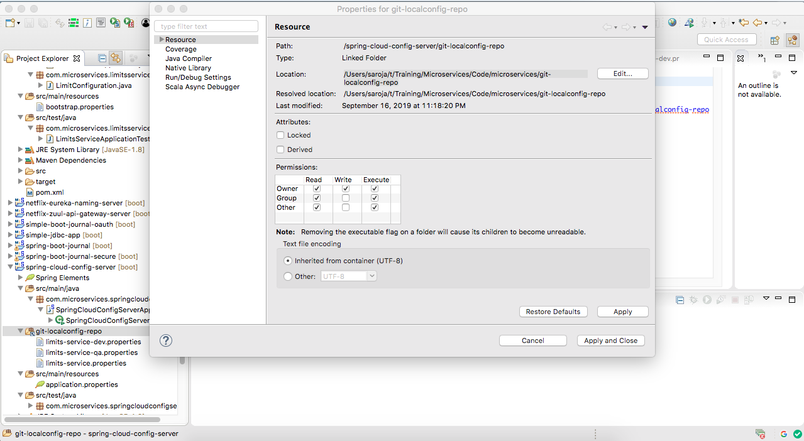
Connect to spring config folder

Slide 13
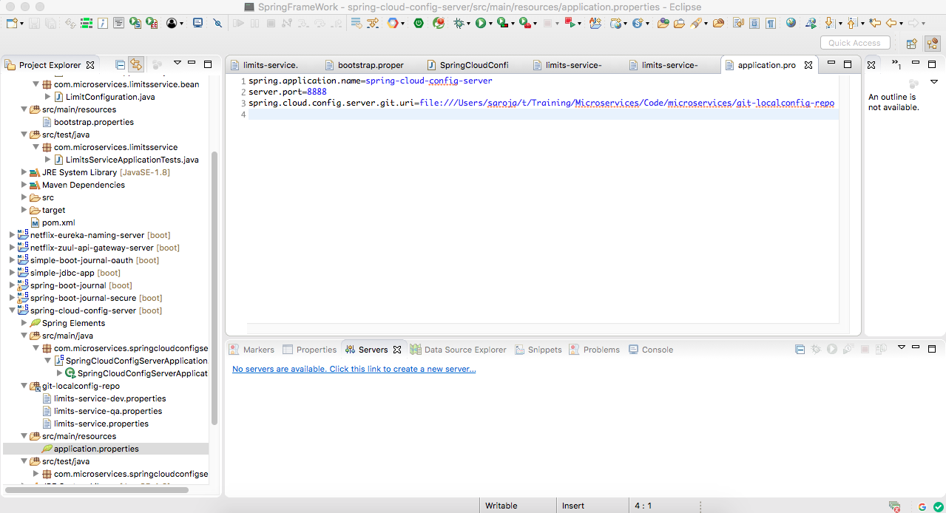

Slide 14
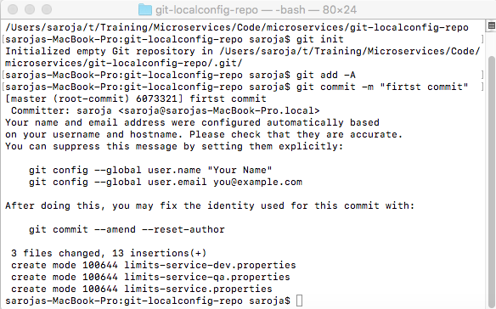

Slide 15
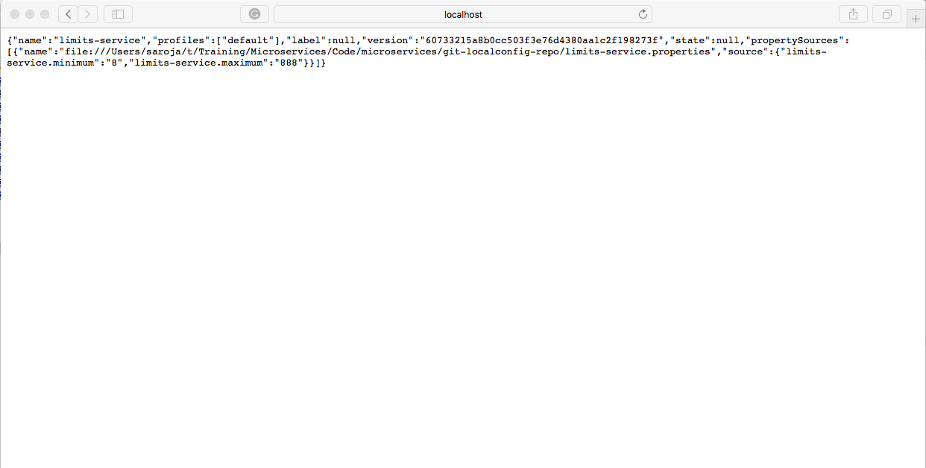

Slide 16
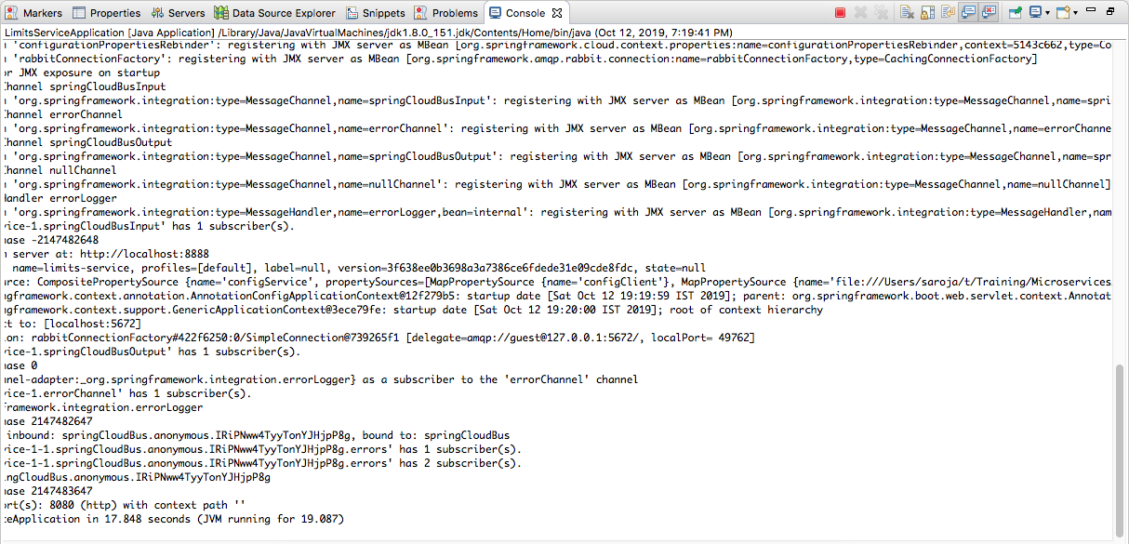
Default Profile

Slide 17
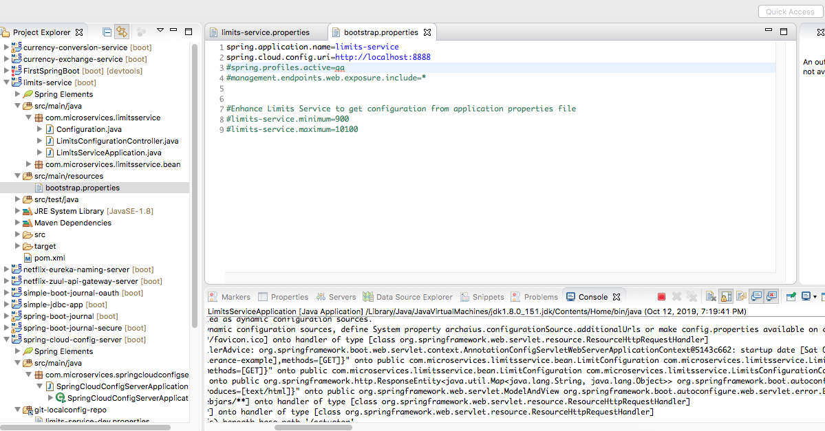

Default Configuaration

Slide 18
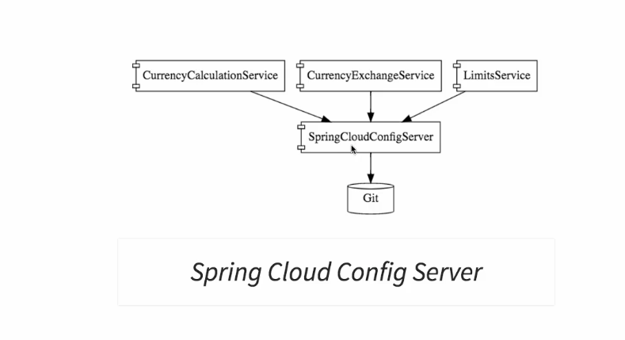
Config Server

Slide 19
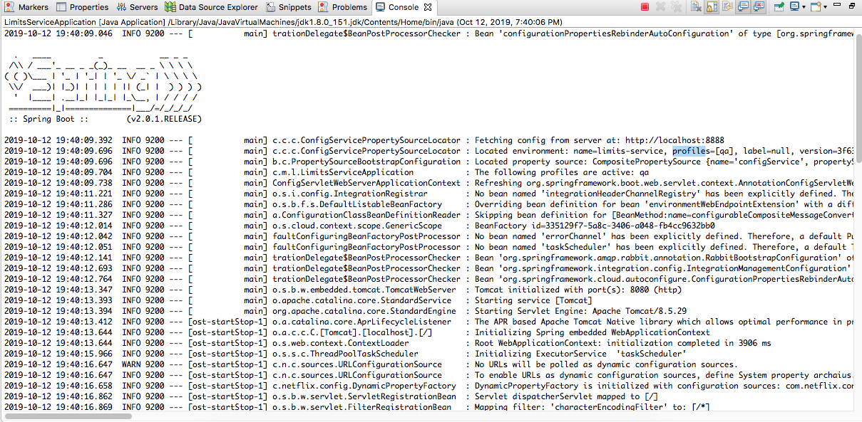

QA Profile

Slide 20
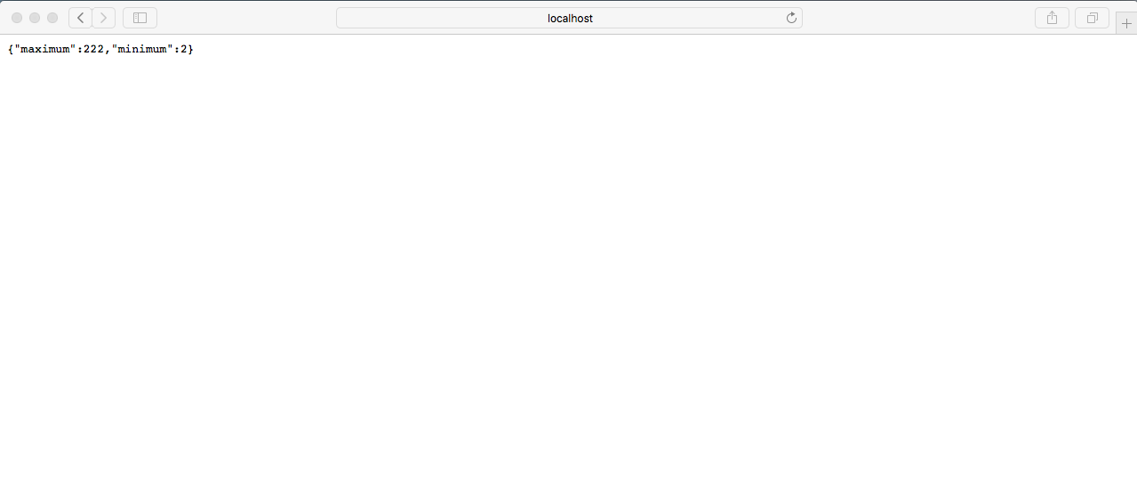
QA Profile Data

Slide 21
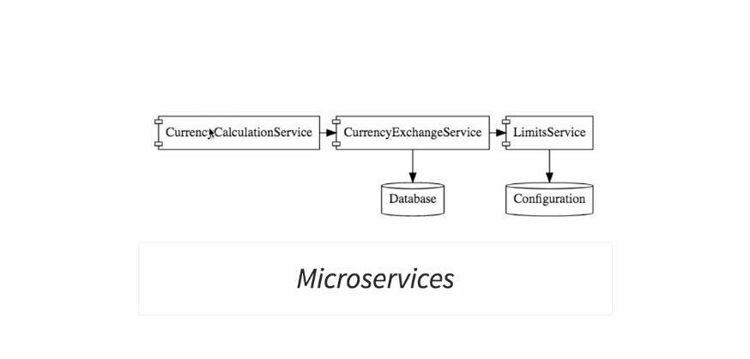
Microservices example architecture

Slide 22
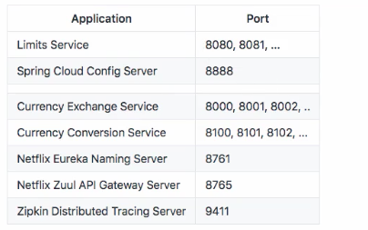
Microservices application ports

Slide 23
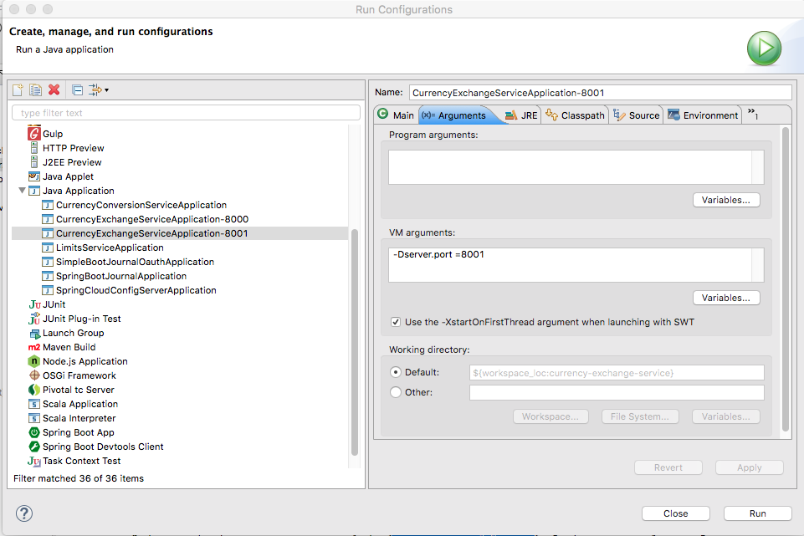
http://localhost:8000/currency-exchange/from/USD/to/INR
http://localhost:8001/currency-exchange/from/USD/to/INR
Setting dynamic port in the response

Slide 24
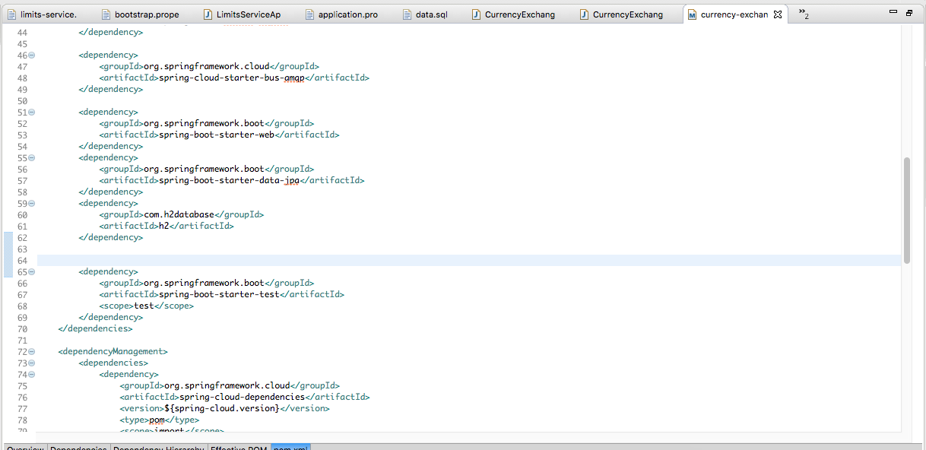
JPA+ H2 Database

Slide 25
Db Query
To connect to DB http://localhost:8000/h2-console

Slide 26
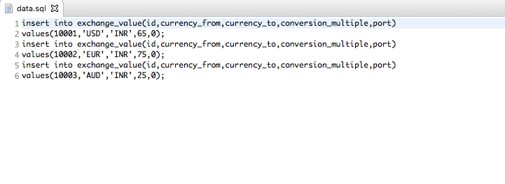

Slide 27
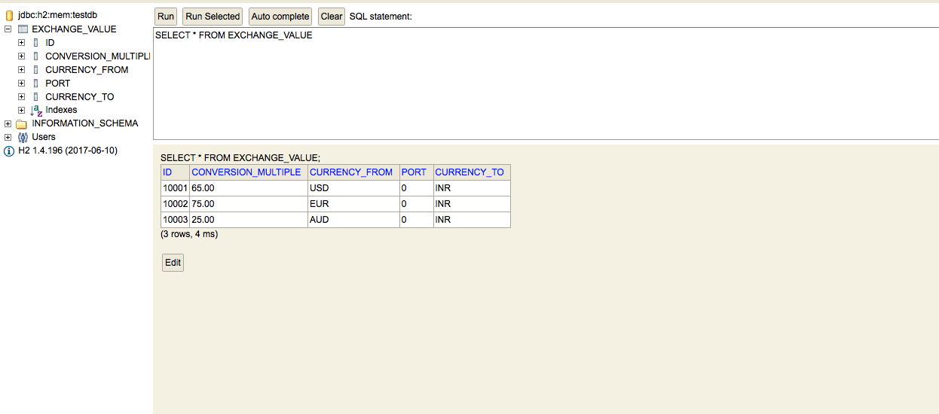
H2 Console

Slide 28
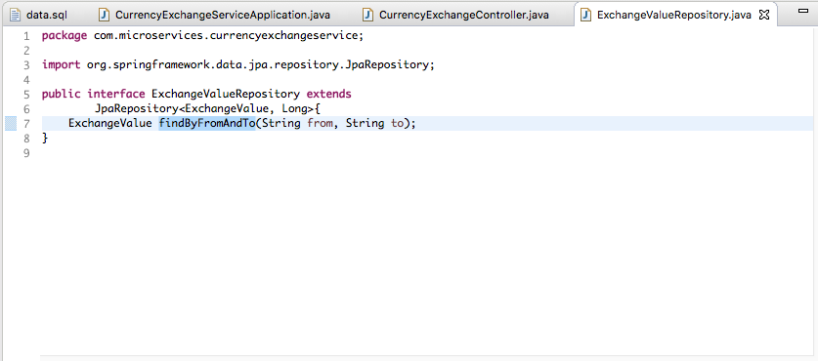
Creating Jpa Repository

Slide 29
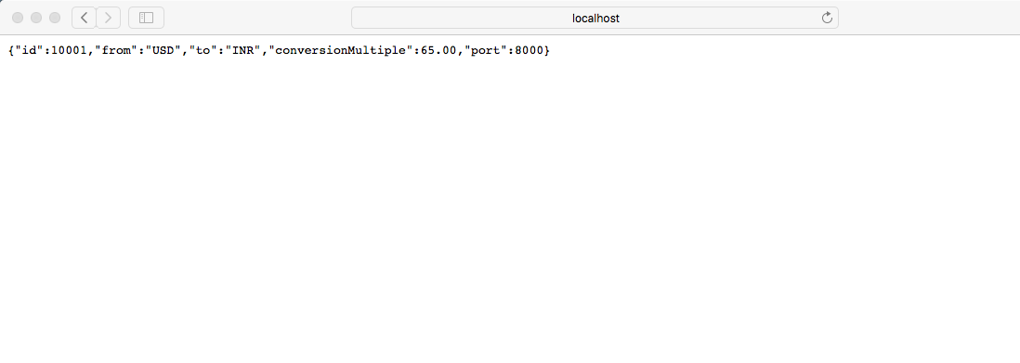
http://localhost:8000/currency-exchange/from/USD/to/INR
http://localhost:8000/currency-exchange/from/EUR/to/INR

Slide 30
Hibernate: select exchangeva0_.id as id1_0_, exchangeva0_.conversion_multiple as conversi2_0_, exchangeva0_.currency_from as currency3_0_, exchangeva0_.port as port4_0_, exchangeva0_.currency_to as currency5_0_ from exchange_value exchangeva0_ where exchangeva0_.currency_from=? and exchangeva0_.currency_to=?
2019-10-13 09:24:04.559 INFO [currency-exchange-service,c31874ecfb1e71c8,c31874ecfb1e71c8,true] 7490 --- [nio-8000-exec-4] c.m.c.CurrencyExchangeController : com.microservices.currencyexchangeservice.ExchangeValue@596361a4
Hibernate: select exchangeva0_.id as id1_0_, exchangeva0_.conversion_multiple as conversi2_0_, exchangeva0_.currency_from as currency3_0_, exchangeva0_.port as port4_0_, exchangeva0_.currency_to as currency5_0_ from exchange_value exchangeva0_ where exchangeva0_.currency_from=? and exchangeva0_.currency_to=?
2019-10-13 09:24:04.718 INFO [currency-exchange-service,28d55acf6c59deab,28d55acf6c59deab,true] 7490 --- [nio-8000-exec-9] c.m.c.CurrencyExchangeController : com.microservices.currencyexchangeservice.ExchangeValue@5aa747e7
2019-10-13 09:24:16.254 INFO [currency-exchange-service,,,] 7490 --- [freshExecutor-0] com.netflix.discovery.DiscoveryClient : Disable delta property : false

Slide 31
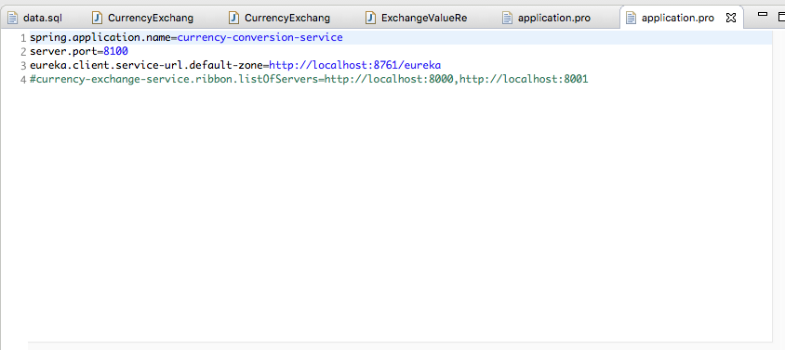
Setting up Currency Conversion Microservices

Slide 32
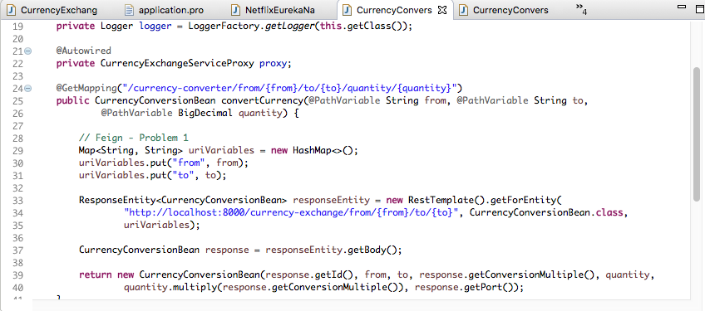
Creating service for currency conversion
Invoking Currecny Exchange Microservice form Currency Conversion

Slide 33
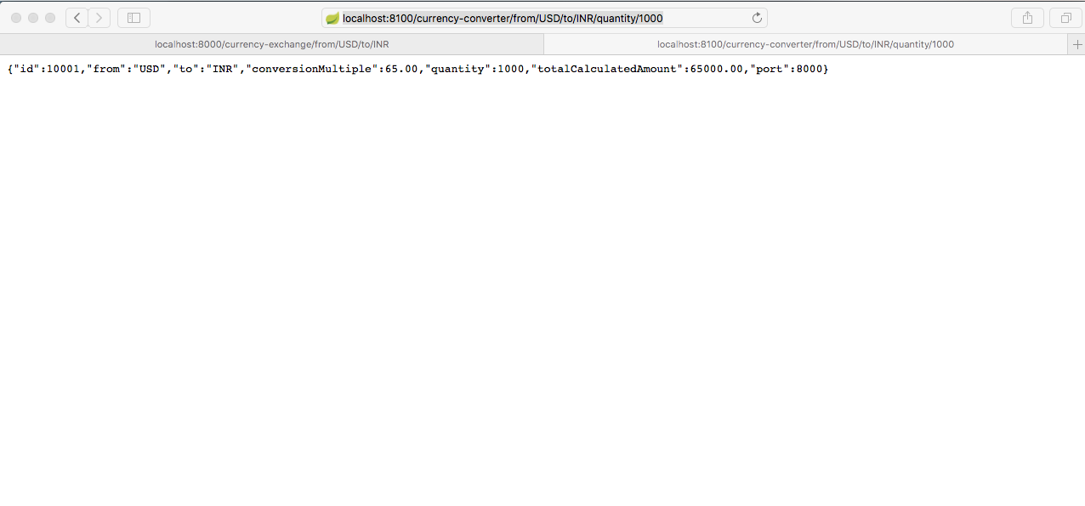
http://localhost:8100/currency-converter/from/USD/to/INR/quantity/1000

Slide 34
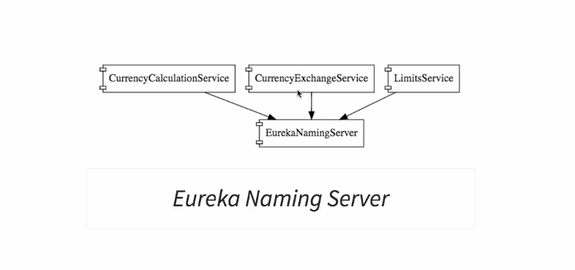
We need the following services to understand Naming Server

Slide 35
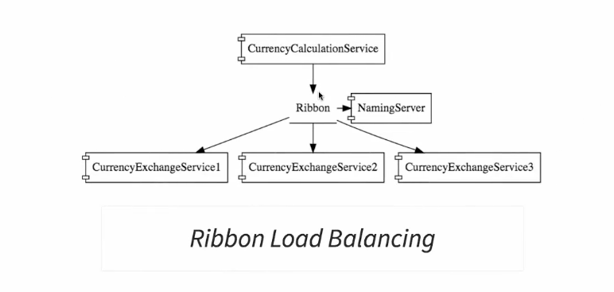
To understand Load Balancing

Slide 36
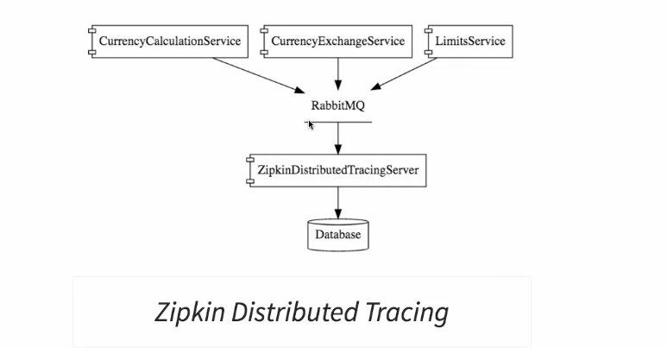

Slide 37
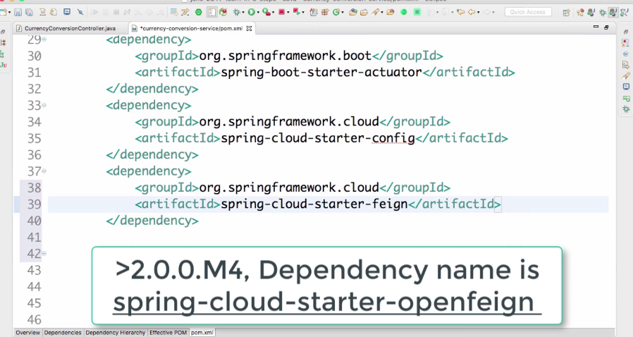
Interservice Dependency With Client side loadbalancing

Slide 38
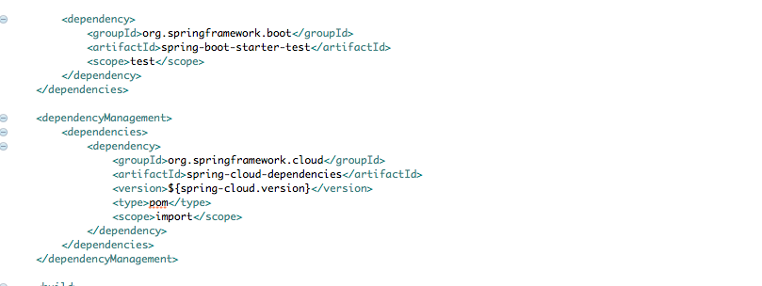
Dependency

Slide 39
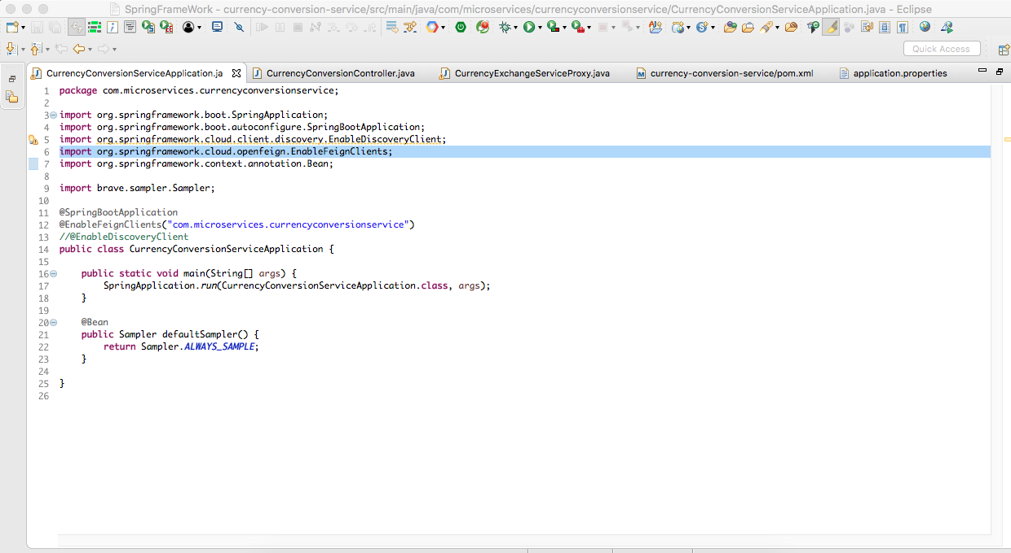
@EnableFeignClients

Slide 40
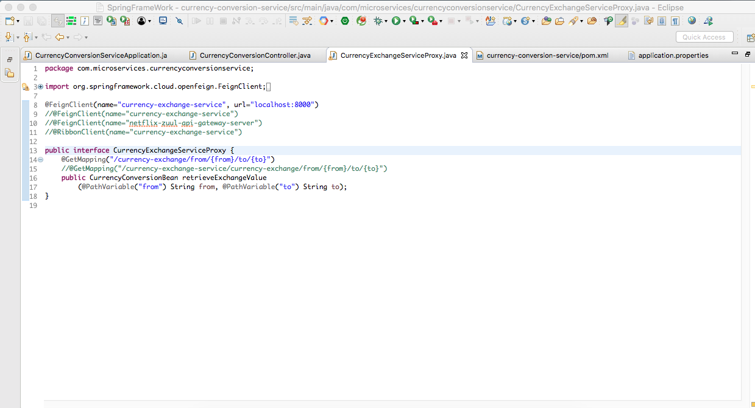
CurrencyExchangeServiceProxy

Slide 41
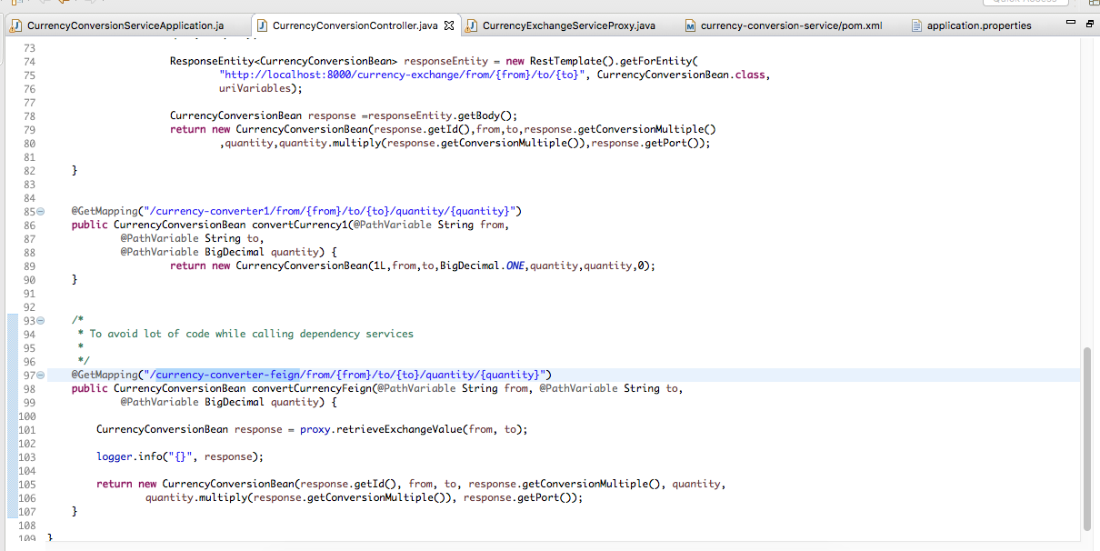
CurrencyConversionController

Slide 42
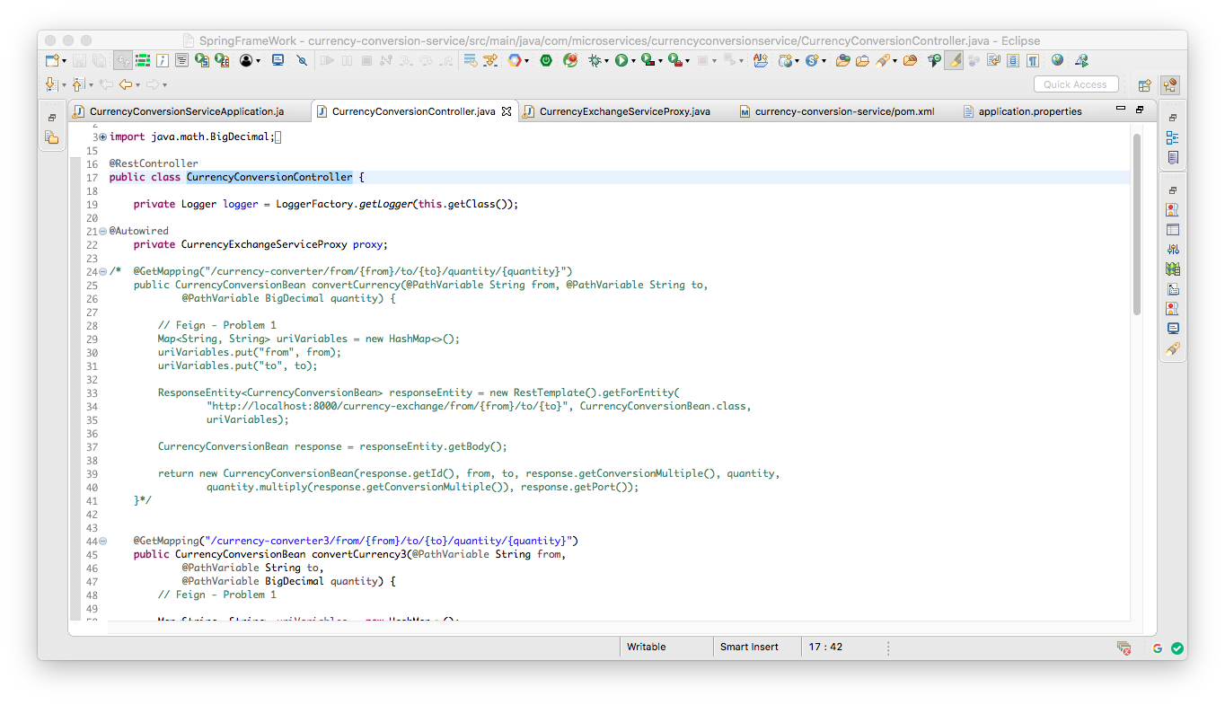
CurrencyExchangeServiceProxy

Slide 43
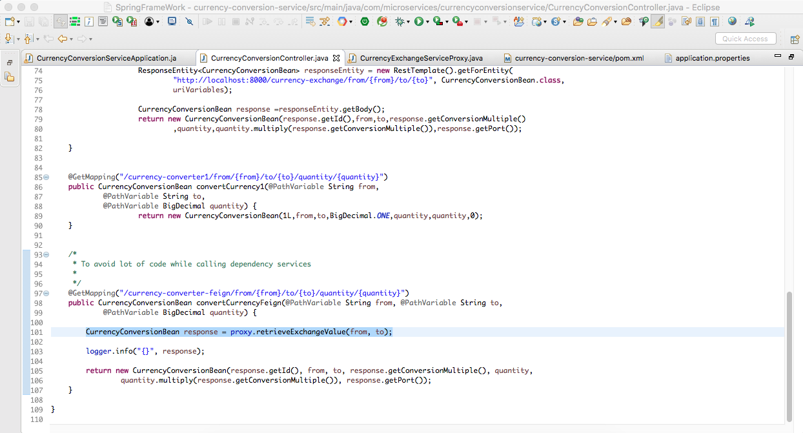
CurrencyConversionBean response = proxy.retrieveExchangeValue(from, to);

Slide 44
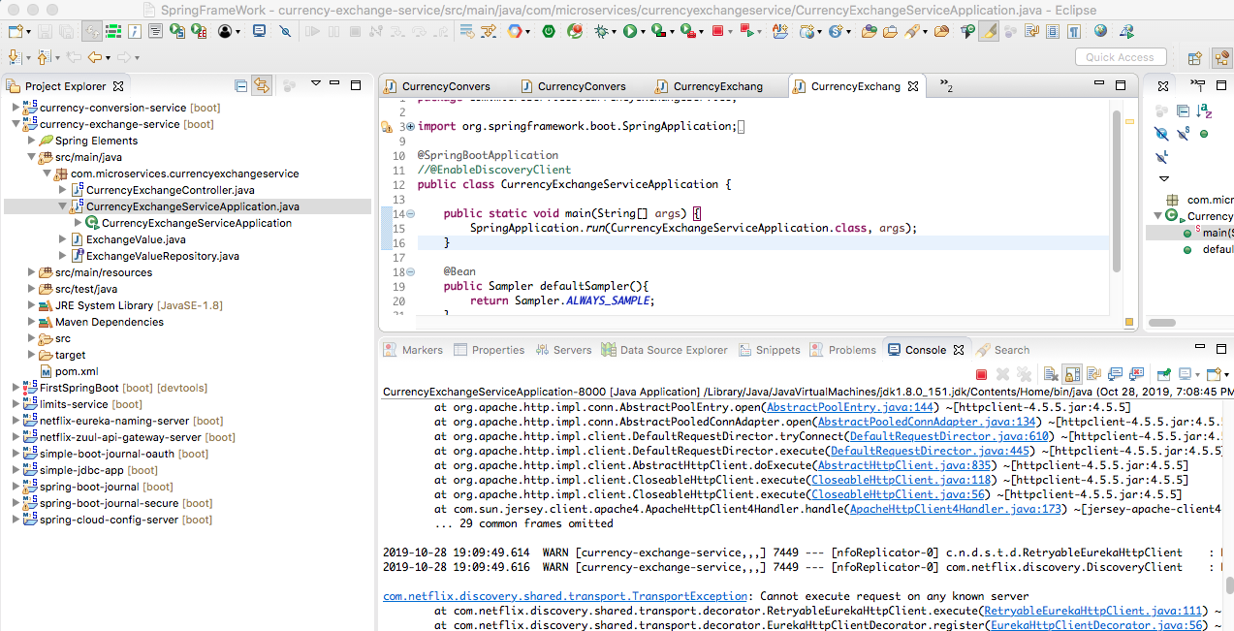

Slide 45
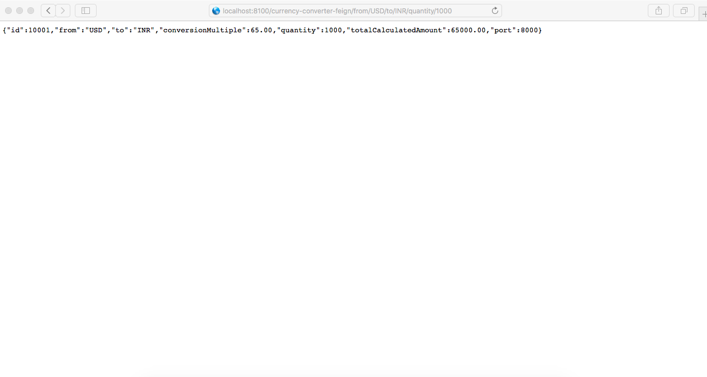
localhost:8100/currency-converter-feign/from/USD/to/INR/quantity/1000

Slide 46
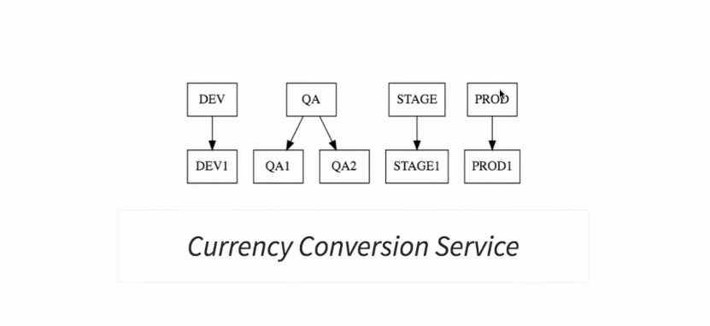
@FeignClient(name="currency-exchange-service", url="localhost:8000")
Notes:
One instance is to be called

Slide 47
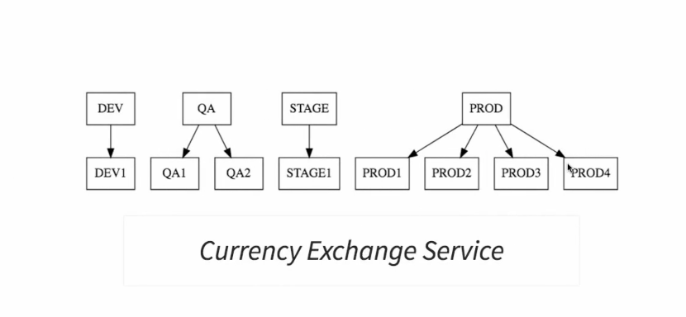
How to handle four instance called Client Side Load Balancing with ribbon
C

Slide 48
Notes:
One instance is to be called

Slide 49
Notes:
One instance is to be called

Slide 50
Notes:
One instance is to be called

Slide 51
Notes:
One instance is to be called

Slide 52
Notes:
One instance is to be called

Slide 53
Notes:
One instance is to be called

Slide 54
Notes:
One instance is to be called

Slide 55
Notes:
One instance is to be called

Slide 56
Notes:
One instance is to be called

Slide 57
Notes:
One instance is to be called

Slide 58
Notes:
One instance is to be called

